Slide 1

From brain drain to brain gain
Can platform work help?
Dr. Bresena Kopliku
University of Shkodra
Department of Geography
Bresena.kopliku@unishk.edu.al

Slide 2
Brain drain
WESTERN BALKANS WORKING AGE POPULATION DECLINED BY MORE THAN 400,000 IN PAST 5 YEARS
Brain drain is particularly significant in Albania, where the highly educated account for around 40% of the total cumulative outflow
From mainly a migration of poverty, high unemployment rates, desperation and protest to a more structural one with the migration mainly of the youngsters and highly educated sections of the population

Slide 3
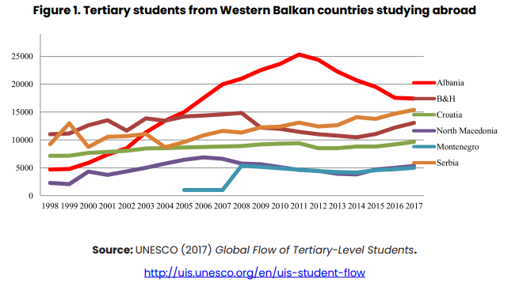

Slide 4
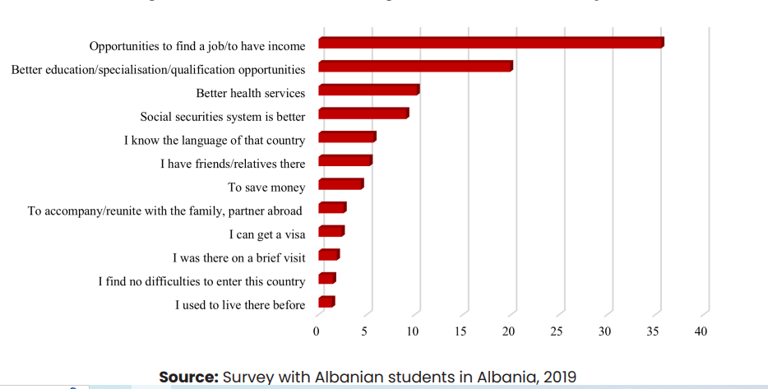
Reasons for choosing a destination country

Slide 5
There are jobs, but there are not professionals…
Over 80% of medium and large businesses and 54% of small businesses reported having ICT vacancies in the last 12 months (2022)
skills mismatch between what the education system equips youth with, and what the labour market requires (digital knowledge, data entry knowledge)
Different approaches to the labour market (life – work balance; creativity)
Vacancies mainly in Tirana
Low wages

Slide 6
Migration from Albania wicked problem
King (2021) a wicked problem is a problem that is extremely difficult or impossible to solve
incomplete information,
contradictory forces,
changing circumstances,
multiple layers of complexity
interdependencies with other problems.

Slide 7
Albania is still locked in the phase of on-going large-scale migration (Gëdeshi & King, 2021; King & Gëdeshi, 2019)
young, educated and qualified people
40% of the emigration from Albania could be classified as brain drain (Leitner, 2021);
still high potential rates of migration
30% (Public Opinion Balkan Barometer).
high unemployment rates,
10,9% (INSTAT 2023)
endemic corruption,
the unfavourable business climate,
informal markets,
Low standard of education and health services
widening socio-economic and spatial differences,

Slide 8
The virtualization of work
Changes of the traditional “social model” of industrialized countries based on place, time and action
Global integration of work
point of entry for new immigrants
Precarious and atypical work conditions
Non – standard jobs in the platform economy
Silver bullet solution for out migration (?)
Job offers from online platforms require employees with not very high data entry skills (basic digital knowledge) to software development projects (specialized knowledge)

Slide 9
Methodology
20 in – depth interviews
8 women/12 men
IT (12), Teaching (4), Architecture (1), Literature (1), Translator (2)
Transcribed, coded, translated, quoted

Slide 10
Migration and cloudwork – web-based
Many cloudworkers embrace the flexible and informal conditions of cloudwork while shuttling back and forth with regular employment
Cloudwork allows them to live middle class lifestyles,
Full time or part time job
Trust more the platform itself than the state
Do not want the policy to intervene in their work
Do not consider migration

Slide 11
Not only ICT …
A. K, (M, 29, chemistry teacher ) My primary source of incomes is the work online because it gives you more, much higher incomes.
K.M (F, 29, math teacher) As for my career, after finishing my master studies for math in Norway, I returned in Albania to teach, I have always thought that teaching would be my only priority, but now, that I have been working for 6 years as a teacher, I think that I like diversity in my jobs, not monotony. I think that through Upwork I can find different possibilities.

Slide 12
Not only ICT …
Five countries(Albania, Bosnia and Herzegovina, Montenegro, North Macedonia and Serbia) were ranked among the top ten in the world for the number of translators in relation to their population
B.K (F, 45, English teacher) I have translated 40 000 words for 10 days, working 4 hours per day, and I was paid 300 Euro, which is quite good for me…It was not difficult, but just voluminous, and no, it can’t be done through google translate…

Slide 13
Minimum wage
293 Euro/month
Average wage
599 Euro/month
Location based gig-work
450 Euro – 1000 Euro/month
Web based gig-work
36646$ /year – 51600$/year

Slide 14
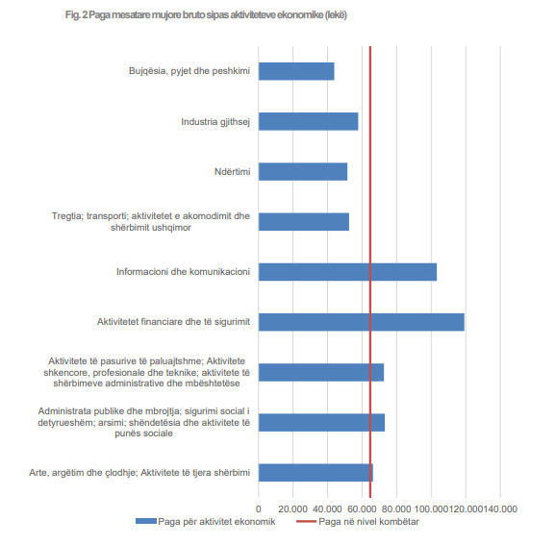

Slide 15
cloudwork
Being things like they are in Albania, I wouldn’t want the state to interfere with what I do…
Food delivery
Yes, stress, unseen stress by the traffic, I have kidney pain. Sometimes I almost get maid, want to grab the phone and throw it on the ground, I'd rather live with a piece of bread.

Slide 16
Conclusions
Brain drain is the biggest challenge of this new decade that should dictate/shape the current and future policy agenda of our economies.
the skills mismatch between what the education system equips youth with, and what the labour market requires.
Cloudwork for return migration and transnationalism – right policies
Platform work can help by allowing highly skilled professionals to work for global companies while at the same time contributing to the country’s economy and development,
The future of work will shape migration trajectories and the migrants–labour market relationship.
Gig platforms are emerging as new players in the political economy in Albania by creating the possibility to bring the salaries of the destination country to the potential migrant and not vice-versa as the traditional theories of migration suggest.
Towards non-linearity of the migration process with a variety of migration paths and sequences
Silence of policy for the gig/platform economy
For a rapid economic and social development and as a consequence less migration it is needed the right policy mix and synergy among elements Olesen (2003).

Slide 17
Thank you!
Altenried, M. A. (2023). Platforms, Labour, and Mobility. In The Routledge Handbook of Gig Economy (pp. 180–189). Routledge. https://doi.org/10.4324/9781003161875-14
Degryse, C. (2023). (Re)Inventing the Collective Dimension in a ‘Virtualised’ Labour Market. In The Routledge Handbook of the Gig Economy (pp. 95–115). Routledge. https://doi.org/10.4324/9781003161875-9
Institute of Statistics Albania [INSTAT]. (2023, June 12). Statistikat e pagave [Press release]. https://www.instat.gov.al/media/11708/pagat_press-rease-t1_-2023-altcom-2.pdf
Ness, I. (2022). The Routledge Handbook of the Gig Economy. Taylor & Francis.
Pichault, F., & Naedenoen, F. (2023). THE CHALLENGES OF TOTAL TALENT MANAGEMENT IN THE GIG ECONOMY. In The Routledge Handbook of Gig Eonomy (pp. 74–93). Routledge. https://www.routledge.com/The-Routledge-Handbook-of-the-Gig-Economy/Ness/p/book/9780367752903#
Van Doorn, N. (2023). Liminal Precarity and Compromised Agency Migrant experiences of gig work in Amsterdam, Berlin, and New York City. In The Routledge Handbook of the Gig Economy (pp. 158–179). Routledge.
VENDIM Nr. 113, datë 1.3.2023 PËR PËRCAKTIMIN E PAGËS MINIMALE NË SHKALLË VENDI. (2023, March 4). AlProfit. https://alprofitconsult.al/vendim-113-date-01-03-2023-per-percaktimin-e-pages-minimale-ne-shkalle-vendi/

